Slide 1
Database Management Systems
By:
Dr. Neha Nandal
Computer Science and Engineering

Slide 2
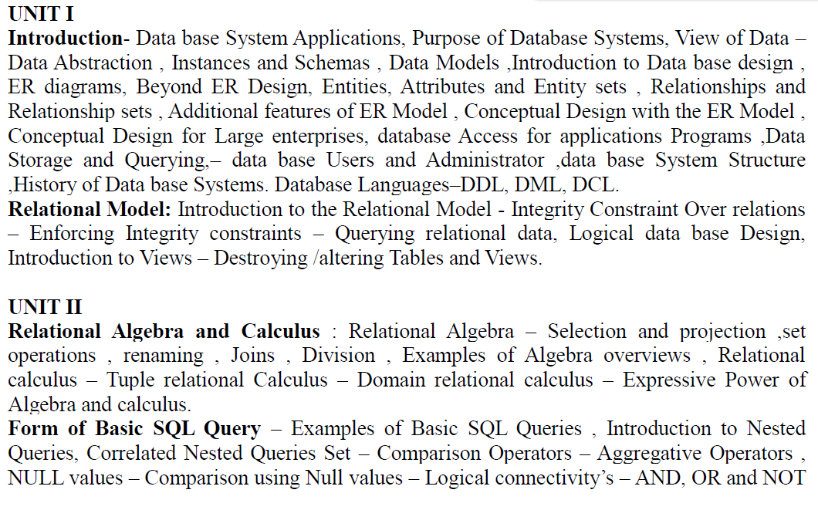
DATABASE MANAGEMENT SYSTEMS

Slide 3
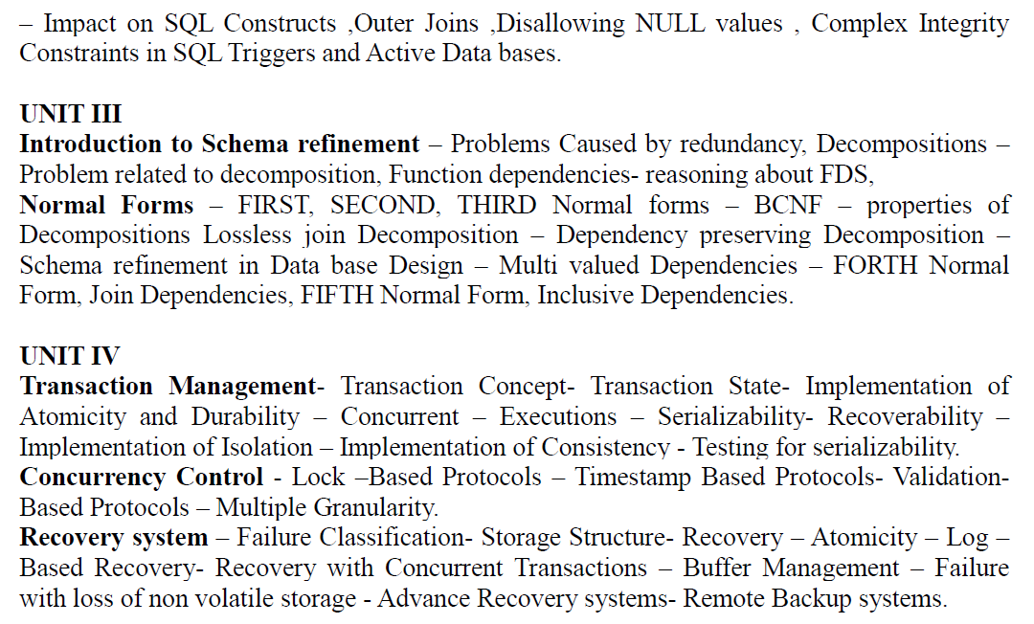
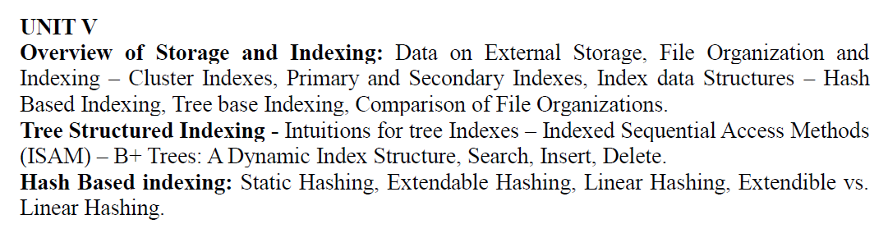

Slide 4
TEXT BOOKS:
1. Data base System Concepts, Silberschatz, Korth, McGraw hill, Sixth Edition.(All UNITS except III th)
2. Data base Management Systems, Raghurama Krishnan, Johannes Gehrke, TATA McGrawHill 3rd Edition.

Slide 5
Unit 2: RELATIONAL ALGEBRA
Relational Algebra is a procedural query language. Relational algebra mainly provides a theoretical foundation for relational databases and SQL. The main purpose of using Relational Algebra is to define operators that transform one or more input relations into an output relation.
As it is pure mathematics, there is no use of English Keywords in Relational Algebra and operators are represented using symbols.

Slide 6
Fundamental Operators
These are the basic/fundamental operators used in Relational Algebra.
Selection(σ)
Projection(π)
Union(U)
Set Difference(-)
Set Intersection(∩)
Rename(ρ)
Cartesian Product(X)

Slide 7
1. Selection(σ):
It is used to select required tuples of the relations.
A | B | C
1 | 2 | 4
2 | 2 | 3
3 | 2 | 3
4 | 3 | 4
A | B | C
1 | 2 | 4
4 | 3 | 4
For this relation, σ(c>3)R will select the tuples which have c more than 3.
Note: The selection operator only selects the required tuples but does not display them. For display, the data projection operator is used.

Slide 8
2. Projection(π):
It is used to project required column data from a relation.
Consider Table 1. Suppose we want columns B and C from Relation R.
π(B,C)R will show following columns.
B | C
2 | 4
2 | 3
3 | 4
Note: By Default, projection removes duplicate data.

Slide 9
3. Union(U):
Union operation in relational algebra is the same as union operation in set theory.
FRENCH
GERMAN
Student_Name | Roll_Number
Ram | 01
Mohan | 02
Vivek | 13
Geeta | 17
Student_Name | Roll_Number
Vivek | 13
Geeta | 17
Shyam | 21
Rohan | 25
Consider the following table of Students having different optional subjects in their course.
π(Student_Name)FRENCH U π(Student_Name)GERMAN

Slide 10
Student_Name
Ram
Mohan
Vivek
Geeta
Shyam
Rohan
Note: The only constraint in the union of two relations is that both relations must have the same set of Attributes.

Slide 11
4. Set Difference(-):
Set Difference in relational algebra is the same set difference operation as in set theory.
From the previous table of FRENCH and GERMAN, Set Difference is used as follows
π(Student_Name)FRENCH - π(Student_Name)GERMAN
Student_Name
Ram
Mohan
Note: The only constraint in the Set Difference between two relations is that both relations must have the same set of Attributes.

Slide 12
5. Rename(ρ): Rename is a unary operation used for renaming attributes of a relation.
ρb(a)R will rename the attribute 'b' of the relation by 'a'.

Slide 13
6. Cross Product(X): Cross-product between two relations. Let’s say A and B, so the cross product between A X B will result in all the attributes of A followed by each attribute of B. Each record of A will pair with every record of B.
Name | Age | Sex
Ram | 14 | M
Sona | 15 | F
Kim | 20 | M
ID | Course
1 | DS
2 | DBMS

Slide 14
A X B
Name | Age | Sex | ID | Course
Ram | 14 | M | 1 | DS
Ram | 14 | M | 2 | DBMS
Sona | 15 | F | 1 | DS
Sona | 15 | F | 2 | DBMS
Kim | 20 | M | 1 | DS
Kim | 20 | M | 2 | DBMS

Slide 15
Derived Operators
These are some of the derived operators, which are derived from the fundamental operators.
Natural Join(⋈)
Intersection
Conditional Join
1. Natural Join(⋈): Natural join is a binary operator. Natural join between two or more relations will result in a set of all combinations of tuples where they have an equal common attribute.

Slide 16
DEPT
EMP
Name | ID | Dept_Name
A | 120 | IT
B | 125 | HR
C | 110 | Sales
D | 111 | IT
Dept_Name | Manager
Sales | Y
Production | Z
IT | A

Slide 17
Natural join between EMP and DEPT with condition :
EMP.Dept_Name = DEPT.Dept_Name
EMP ⋈ DEPT
Name | ID | Dept_Name | Manager
A | 120 | IT | A
C | 110 | Sales | Y
D | 111 | IT | A

Slide 18
Set Intersection(∩): Set Intersection in relational algebra is the same set intersection operation in set theory.
Example: From the above table of FRENCH and GERMAN, the Set Intersection is used as follows
π(Student_Name)FRENCH ∩ π(Student_Name)GERMAN
Student_Name
Vivek
Geeta
Note: The only constraint in the Set Difference between two relations is that both relations must have the same set of Attributes.

Slide 19
Question:
Consider the following relational database schema consisting of the four relation schemas:
passenger ( pid, pname, pgender, pcity)
agency ( aid, aname, acity)
flight (fid, fdate, time, src, dest)
booking (pid, aid, fid, fdate)
a) Get the complete details of all flights to New Delhi.

Slide 20
Question:
Consider the following relational database schema consisting of the four relation schemas:
passenger ( pid, pname, pgender, pcity)
agency ( aid, aname, acity)
flight (fid, fdate, time, src, dest)
booking (pid, aid, fid, fdate)
a) Get the complete details of all flights to New Delhi.
σ _{destination = “New Delhi”} (flight)

Slide 21
Question:
Consider the following relational database schema consisting of the four relation schemas:
passenger ( pid, pname, pgender, pcity)
agency ( aid, aname, acity)
flight (fid, fdate, time, src, dest)
booking (pid, aid, fid, fdate)
b) Get the details about all flights from Chennai to New Delhi.

Slide 22
Question:
Consider the following relational database schema consisting of the four relation schemas:
passenger ( pid, pname, pgender, pcity)
agency ( aid, aname, acity)
flight (fid, fdate, time, src, dest)
booking (pid, aid, fid, fdate)
b) Get the details about all flights from Chennai to New Delhi.
σ src = “Chennai” ^ dest = “New Delhi” (flight)

Slide 23
Question:
Consider the following relational database schema consisting of the four relation schemas:
passenger ( pid, pname, pgender, pcity)
agency ( aid, aname, acity)
flight (fid, fdate, time, src, dest)
booking (pid, aid, fid, fdate)
c) Find only the flight numbers for passenger with pid 123 for flights to Chennai before 06/11/2020.

Slide 24
Question:
Consider the following relational database schema consisting of the four relation schemas:
passenger ( pid, pname, pgender, pcity)
agency ( aid, aname, acity)
flight (fid, fdate, time, src, dest)
booking (pid, aid, fid, fdate)
c) Find only the flight numbers for passenger with pid 123 for flights to Chennai before 06/11/2020.
Π _{fid} (σ _{pid = 123} (booking) ⨝ σ dest = “Chennai” ^ fdate < 06/11/2020 (flight))

Slide 25
Question:
Consider the following relational database schema consisting of the four relation schemas:
passenger ( pid, pname, pgender, pcity)
agency ( aid, aname, acity)
flight (fid, fdate, time, src, dest)
booking (pid, aid, fid, fdate)
d) Find the passenger names for passengers who have bookings on at least one flight.

Slide 26
Question:
Consider the following relational database schema consisting of the four relation schemas:
passenger ( pid, pname, pgender, pcity)
agency ( aid, aname, acity)
flight (fid, fdate, time, src, dest)
booking (pid, aid, fid, fdate)
d) Find the passenger names for passengers who have bookings on at least one flight.
Π _{pname} (passenger ⨝ booking)

Slide 27
Question:
Consider the following relational database schema consisting of the four relation schemas:
passenger ( pid, pname, pgender, pcity)
agency ( aid, aname, acity)
flight (fid, fdate, time, src, dest)
booking (pid, aid, fid, fdate)
e) Find the passenger names for those who do not have any bookings in any flights.

Slide 28
Question:
Consider the following relational database schema consisting of the four relation schemas:
passenger ( pid, pname, pgender, pcity)
agency ( aid, aname, acity)
flight (fid, fdate, time, src, dest)
booking (pid, aid, fid, fdate)
e) Find the passenger names for those who do not have any bookings in any flights.
Π _{pname} ((Π _{pid} (passenger) - Π _{pid} (booking)) ⨝ passenger)

Slide 29
Question:
Consider the following relational database schema consisting of the four relation schemas:
passenger ( pid, pname, pgender, pcity)
agency ( aid, aname, acity)
flight (fid, fdate, time, src, dest)
booking (pid, aid, fid, fdate)
f) Find the agency names for agencies that located in the same city as passenger with passenger id 123.

Slide 30
Question:
Consider the following relational database schema consisting of the four relation schemas:
passenger ( pid, pname, pgender, pcity)
agency ( aid, aname, acity)
flight (fid, fdate, time, src, dest)
booking (pid, aid, fid, fdate)
f) Find the agency names for agencies that located in the same city as passenger with passenger id 123.
Π _{aname} (agency ⨝ _{acity = pcity} (σ _{pid = 123} (passenger)))

Slide 31
Question:
Consider the following relational database schema consisting of the four relation schemas:
passenger ( pid, pname, pgender, pcity)
agency ( aid, aname, acity)
flight (fid, fdate, time, src, dest)
booking (pid, aid, fid, fdate)
g) Get the details of flights that are scheduled on both dates 01/12/2020 and 02/12/2020 at 16:00 hours.

Slide 32
Question:
Consider the following relational database schema consisting of the four relation schemas:
passenger ( pid, pname, pgender, pcity)
agency ( aid, aname, acity)
flight (fid, fdate, time, src, dest)
booking (pid, aid, fid, fdate)
g) Get the details of flights that are scheduled on both dates 01/12/2020 and 02/12/2020 at 16:00 hours.
(σ fdate = 01/12/2020 ^ time = 16:00 (flight)) ∩ (σ fdate = 02/12/2020 ^ time = 16:00 (flight))

Slide 33
Question:
Consider the following relational database schema consisting of the four relation schemas:
passenger ( pid, pname, pgender, pcity)
agency ( aid, aname, acity)
flight (fid, fdate, time, src, dest)
booking (pid, aid, fid, fdate)
h) Get the details of flights that are scheduled on either of the dates 01/12/2020 or 02/12/2020 or both at 16:00 hours.

Slide 34
Question:
Consider the following relational database schema consisting of the four relation schemas:
passenger ( pid, pname, pgender, pcity)
agency ( aid, aname, acity)
flight (fid, fdate, time, src, dest)
booking (pid, aid, fid, fdate)
h) Get the details of flights that are scheduled on either of the dates 01/12/2020 or 02/12/2020 or both at 16:00 hours.
(σ fdate = 01/12/2020 ^ time = 16:00 (flight)) ∪ (σ fdate = 02/12/2020 ^ time = 16:00 (flight))

Slide 35
Question:
Consider the following relational database schema consisting of the four relation schemas:
passenger ( pid, pname, pgender, pcity)
agency ( aid, aname, acity)
flight (fid, fdate, time, src, dest)
booking (pid, aid, fid, fdate)
i) Find the agency names for agencies who do not have any bookings for passenger with id 123.

Slide 36
Question:
Consider the following relational database schema consisting of the four relation schemas:
passenger ( pid, pname, pgender, pcity)
agency ( aid, aname, acity)
flight (fid, fdate, time, src, dest)
booking (pid, aid, fid, fdate)
i) Find the agency names for agencies who do not have any bookings for passenger with id 123.
Π _{aname} (agency ⨝ (Π _{aid} (agency) – Π _{aid} (σ _{pid = 123} (booking)))

Slide 37
Question:
Consider the following relational database schema consisting of the four relation schemas:
passenger ( pid, pname, pgender, pcity)
agency ( aid, aname, acity)
flight (fid, fdate, time, src, dest)
booking (pid, aid, fid, fdate)
j) Find the details of all male passengers who are associated with Jet agency.

Slide 38
Question:
Consider the following relational database schema consisting of the four relation schemas:
passenger ( pid, pname, pgender, pcity)
agency ( aid, aname, acity)
flight (fid, fdate, time, src, dest)
booking (pid, aid, fid, fdate)
j) Find the details of all male passengers who are associated with Jet agency.
Π _{passengers.pid, pname, pcity} (σ pgender = “Male” ^ aname = ‘Jet’ (passengers ⨝ booking ⨝ agency))

Slide 39
Relational Calculus
As Relational Algebra is a procedural query language, Relational Calculus is a non-procedural query language. It basically deals with the end results. It always tells me what to do but never tells me how to do it.
There are two types of Relational Calculus
Tuple Relational Calculus(TRC)
Domain Relational Calculus(DRC)

Slide 40
Tuple Relational Calculus (TRC) is a non-procedural query language used in relational database management systems (RDBMS) to retrieve data from tables. TRC is based on the concept of tuples, which are ordered sets of attribute values that represent a single row or record in a database table.
TRC is a declarative language, meaning that it specifies what data is required from the database, rather than how to retrieve it. TRC queries are expressed as logical formulas that describe the desired tuples.
Syntax: The basic syntax of TRC is as follows:
{ t | P(t) }
where t is a tuple variable and P(t) is a logical formula that describes the conditions that the tuples in the result must satisfy. The curly braces {} are used to indicate that the expression is a set of tuples.

Slide 41
Employee ID
Name
Salary
Department ID
To retrieve the names of all employees who earn more than $50,000 per year, we can use the following TRC query:
{ t | Employees(t) ∧ t.Salary > 50000 }
In this query, the “Employees(t)” expression specifies that the tuple variable t represents a row in the “Employees” table. The “∧” symbol is the logical AND operator, which is used to combine the condition “t.Salary > 50000” with the table selection.

Slide 42
In Tuple Calculus, a query is expressed as
{t| P(t)}
where t = resulting tuples,
P(t) = known as Predicate and these are the conditions that are used to fetch t. Thus, it generates a set of all tuples t, such that Predicate P(t) is true for t.
P(t) may have various conditions logically combined with OR (∨), AND (∧), NOT(¬).
It also uses quantifiers:
∃ t ∈ r (Q(t)) = ”there exists” a tuple in t in relation r such that predicate Q(t) is true.
∀ t ∈ r (Q(t)) = Q(t) is true “for all” tuples in relation r.

Slide 43
Table Customer
Table Branch
Table Borrower
Customer name | Street | City
Saurabh | A7 | Patiala
Mehak | B6 | Jalandhar
Sumiti | D9 | Ludhiana
Ria | A5 | Patiala
Branch name | Branch City
ABC | Patiala
DEF | Ludhiana
GHI | Jalandhar
Customer name | Loan number
Saurabh | L33
Mehak | L49
Ria | L98
Table Account
Table Loan
Table Depositor
Account number | Branch name | Balance
1111 | ABC | 50000
1112 | DEF | 10000
1113 | GHI | 9000
1114 | ABC | 7000
Loan number | Branch name | Amount
L33 | ABC | 10000
L35 | DEF | 15000
L49 | GHI | 9000
L98 | DEF | 65000
Customer name | Account number
Saurabh | 1111
Mehak | 1113
Suniti | 1114

Slide 44
Find the loan number, branch, and amount of loans greater than or equal to 10000 amount.
{t| t ∈ loan ∧ t[amount]>=10000}
Loan number | Branch name | Amount
L33 | ABC | 10000
L35 | DEF | 15000
L98 | DEF | 65000

Slide 45
Find the loan number for each loan of an amount greater or equal to 10000.
{t| ∃ s ∈ loan(t[loan number] = s[loan number]
∧ s[amount]>=10000)}
Loan number
L33
L35
L98

Slide 46
Find the names of all customers who have a loan and an account at the bank.
{t | ∃ s ∈ borrower( t[customer-name] = s[customer-name])
∧ ∃ u ∈ depositor( t[customer-name] = u[customer-name])}
Customer name
Saurabh
Mehak

Slide 47
Find the names of all customers having a loan at the “ABC” branch.
{t | ∃ s ∈ borrower(t[customer-name] = s[customer-name]
∧ ∃ u ∈ loan(u[branch-name] = “ABC” ∧ u[loan-number] = s[loan-number]))}
Customer name
Saurabh

Slide 48
Domain Relational Calculus (DRC)
Domain Relational Calculus is similar to Tuple Relational Calculus, where it makes a list of the attributes that are to be chosen from the relations as per the conditions.
{<a1,a2,a3,.....an> | P(a1,a2,a3,.....an)}
where a1,a2,…an are the attributes of the relation and P is the condition.

Slide 49
Customer
Loan
Customer name | Street | City
Debomit | Kadamtala | Alipurduar
Sayantan | Udaypur | Balurghat
Soumya | Nutanchati | Bankura
Ritu | Juhu | Mumbai
Loan number | Branch name | Amount
L01 | Main | 200
L03 | Main | 150
L10 | Sub | 90
L08 | Main | 60
Borrower
Customer name | Loan number
Ritu | L01
Debomit | L08
Soumya | L03

Slide 50
Query-1: Find the loan number, branch, amount of loans of greater than or equal to 100 amount.
{≺l, b, a≻ | ≺l, b, a≻ ∈ loan ∧ (a ≥ 100)}
Loan number | Branch name | Amount
L01 | Main | 200
L03 | Main | 150

Slide 51
Query-2: Find the loan number for each loan of an amount greater or equal to 150.
{≺l≻ | ∃ b, a (≺l, b, a≻ ∈ loan ∧ (a ≥ 150)}
Loan number
L01
L03

Slide 52
Query-3: Find the names of all customers having a loan at the “Main” branch and find the loan amount .
{≺c, a≻ | ∃ l (≺c, l≻ ∈ borrower ∧ ∃ b (≺l, b, a≻ ∈ loan ∧ (b = “Main”)))}
Customer Name | Amount
Ritu | 200
Debomit | 60
Soumya | 150

Slide 53
S. No. | Basis of Comparison | Tuple Relational Calculus (TRC) | Domain Relational Calculus (DRC)
1. | Definition | The Tuple Relational Calculus (TRC) is used to select tuples from a relation. The tuples with specific range values, tuples with certain attribute values, and so on can be selected. | The Domain Relational Calculus (DRC) employs a list of attributes from which to choose based on the condition. It’s similar to TRC, but instead of selecting entire tuples, it selects attributes.
2. | Representation of variables | In TRC, the variables represent the tuples from specified relations. | In DRC, the variables represent the value drawn from a specified domain.
3. | Tuple/ Domain | A tuple is a single element of relation. In database terms, it is a row. | A domain is equivalent to column data type and any constraints on the value of data.
4. | Filtering | This filtering variable uses a tuple of relations. | This filtering is done based on the domain of attributes.
5. | Return Value | The predicate expression condition associated with the TRC is used to test every row using a tuple variable and return those tuples that met the condition. | DRC takes advantage of domain variables and, based on the condition set, returns the required attribute or column that satisfies the criteria of the condition.
5. | Membership condition | The query cannot be expressed using a membership condition. | The query can be expressed using a membership condition.
6. | Query Language | The QUEL or Query Language is a query language related to it, | The QBE or Query-By-Example is query language related to it.
7. | Similarity | It reflects traditional pre-relational file structures. | It is more similar to logic as a modeling language.
8. | Syntax | Notation: {T | P (T)} or {T | Condition (T)} | Notation: { a1, a2, a3, …, an | P (a1, a2, a3, …, an)}
9. | Example | {T | EMPLOYEE (T) AND T.DEPT_ID = 10} | { | < EMPLOYEE > DEPT_ID = 10 }
10. | Focus | Focuses on selecting tuples from a relation | Focuses on selecting values from a relation
11. | Variables | Uses tuple variables (e.g., t) | Uses scalar variables (e.g., a1, a2, …, an)
12. | Expressiveness | Less expressive | More expressive
13. | Ease of use | Easier to use for simple queries. | More difficult to use for simple queries.
14. | Use case | Useful for selecting tuples that satisfy a certain condition or for retrieving a subset of a relation. | Useful for selecting specific values or for constructing more complex queries that involve multiple relations.

Slide 54
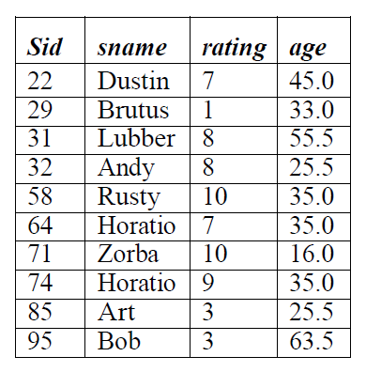
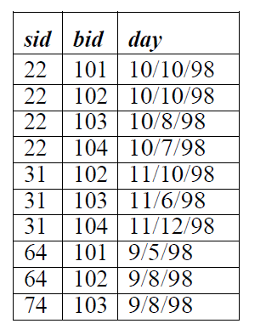
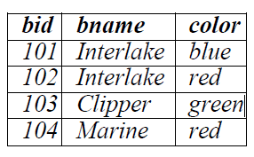
BASIC SQL QUERY
S of Sailors
R of Reserves
B of Boats

Slide 55
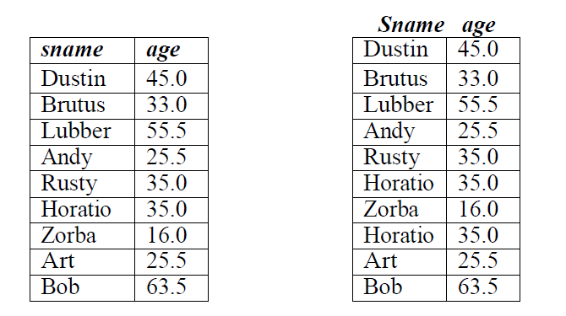
Q: Find the names and ages of all sailors
SELECT DISTINCT S.sname, S.age FROM Sailors S
Answer without DISTINCT

Slide 56
Q: Find all sailors with a rating above 7.
SELECT S.sid, S.sname, S.rating, S.age FROM Sailors AS S WHERE S.rating > 7
Q: Find the sids of sailors who have reserved a red boat.
SELECT R.sid FROM Boats B, Reserves R WHERE B.bid = R.bid AND B.color = ‘red’

Slide 57
Q: Find the ages of sailors whose name begins and ends with B and has at least
three characters.
SELECT S.age FROM Sailors S WHERE S.sname LIKE ‘B %B’
UNION, INTERSECT, AND EXCEPT
Q: Find the names of sailors who have reserved a red or a green boat.
SELECT S.sname FROM Sailors S, Reserves R, Boats B WHERE S.sid = R.sid
AND R.bid = B.bid AND (B.color = ‘red’ OR B.color = ‘green’)
The OR query (Query Q5) can be rewritten as follows:
SELECT S.sname
FROM Sailors S, Reserves R, Boats B
WHERE S.sid = R.sid AND R.bid = B.bid AND B.color = ‘red’
UNION
SELECT S2.sname
FROM Sailors S2, Boats B2, Reserves R2
WHERE S2.sid = R2.sid AND R2.bid = B2.bid AND B2.color = ‘green’

Slide 58
Find the names of sailors who have reserved both a red and a green boat.
SELECT S.sname FROM Sailors S, Reserves R1, Boats B1, Reserves R2, Boats
B2 WHERE S.sid = R1.sid AND R1.bid = B1.bid AND S.sid = R2.sid AND
R2.bid = B2.bid AND B1.color=‘red’ AND B2.color = ‘green’
The AND query can be rewritten as follows:
SELECT S.sname
FROM Sailors S, Reserves R, Boats B
WHERE S.sid = R.sid AND R.bid = B.bid AND B.color = ‘red’
INTERSECT
SELECT S2.sname
FROM Sailors S2, Boats B2, Reserves R2
WHERE S2.sid = R2.sid AND R2.bid = B2.bid AND B2.color = ‘green’

Slide 59
Find the sids of all sailors who have reserved red boats but not green boats.
SELECT S.sid FROM Sailors S, Reserves R, Boats B
WHERE S.sid = R.sid AND R.bid = B.bid AND B.color = ‘red’
EXCEPT SELECT S2.sid FROM Sailors S2, Reserves R2, Boats B2
WHERE S2.sid = R2.sid AND R2.bid = B2.bid AND B2.color = ‘green’
we can use the following simpler query:
SELECT R.sid FROM Boats B, Reserves R
WHERE R.bid = B.bid AND B.color = ‘red’
EXCEPT SELECT R2.sid FROM Boats B2,
Reserves R2 WHERE R2.bid = B2.bid AND
B2.color = ‘green’

Slide 60
NESTED QUERIES
A nested query is a query that has another query embedded within it; the embedded query is called a subquery.
Find the names of sailors who have reserved boat 103.
SELECT S.sname
FROM Sailors S
WHERE S.sid IN ( SELECT R.sid
FROM Reserves R
WHERE R.bid = 103 )
The nested subquery computes the (multi)set of sids for sailors who have reserved boat 103 (the set contains 22, 31, and 74 on instances R2 and S3), and the top-level query retrieves the names of sailors whose sid is in this set. The IN operator allows us to test whether a value is in a given set of elements; an SQL query is used to generate
the set to be tested.

Slide 61
Correlated Nested Queries
In the nested queries that we have seen thus far, the inner subquery has been completely independent of the outer query. In general the inner subquery could depend on the row that is currently being examined in the outer query (in terms of our conceptual evaluation strategy). Let us rewrite the following query once more:
The EXISTS operator is another set comparison operator, such as IN. It allows us to test whether a set is nonempty. Thus, for each Sailor row S, we test whether the set of Reserves rows R such that R.bid = 103 AND S.sid = R.sid is nonempty. If so, sailor S has reserved boat 103, and we retrieve the name. The subquery clearly depends on the current row S and must be re-evaluated for each row in Sailors. The occurrence of S in the subquery (in the form of the literal S.sid) is called a correlation, and such queries are
called correlated queries.
Find the names of sailors who have reserved boat number 103.
SELECT S.sname
FROM Sailors S
WHERE EXISTS ( SELECT *
FROM Reserves R
WHERE R.bid = 103
AND R.sid = S.sid )

Slide 62
AGGREGATE OPERATORS
We now consider a powerful class of constructs for computing aggregate values such as MIN and SUM. These features represent a significant extension of relational algebra. SQL supports five aggregate operations, which can be applied on any column, say A, of a relation:
1. COUNT ([DISTINCT] A): The number of (unique) values in the A column.
2. SUM ([DISTINCT] A): The sum of all (unique) values in the A column.
3. AVG ([DISTINCT] A): The average of all (unique) values in the A column.
4. MAX (A): The maximum value in the A column.
5. MIN (A): The minimum value in the A column.

Slide 63
Count the number of different sailor names.
SELECT COUNT( DISTINCT S.sname )
FROM Sailors S
Calculate the average age of all sailors.
SELECT AVG(s.age)
FROM Sailors S
Find the name and the age of the youngest sailor.
SELECT S.sname, S.age
FROM Sailors S
WHERE S.age = (SELECT MIN(S2.age)
FROM Sailors S2 )

Slide 64
The GROUP BY and HAVING Clauses
we want to apply aggregate operations to each of a number of groups of rows in a relation, where the number of groups depends on the relation instance (i.e., is not known in advance). For example, consider the following query.
Find the age of the youngest sailor for each rating level.
SELECT MIN (S.age)
FROM Sailors S
WHERE S.rating = I
where i = 1, 2, . . . , 10. Writing 10 such queries is tedious. More importantly, we may not
know what rating levels exist in advance.

Slide 65
SELECT[ DISTINCT ] select-list
FROM from-list
WHERE qualification
GROUP BY grouping-list
HAVING group-qualification
SELECT S.rating, MIN (S.age)
FROM Sailors S
GROUP BY S.rating

Slide 66
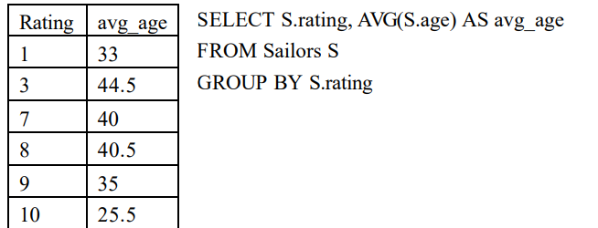
Find the average age of sailors for each rating level.

Slide 67
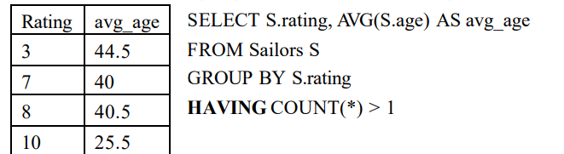
Find the average age of sailors for each rating level that has at least two sailors.

Slide 68
MySQL Triggers
A MySQL trigger is a stored program (with queries) which is executed automatically to respond to a specific event such as insertion, updation or deletion occurring in a table.
1. Before Update Trigger:
As the name implies, it is a trigger which enacts before an update is invoked. If we write an update statement, then the actions of the trigger will be performed before the update is implemented.

Slide 69
create table customer (acc_no integer primary key,
cust_name varchar(20),
avail_balance decimal);
create table mini_statement (acc_no integer,
avail_balance decimal,
foreign key(acc_no) references customer(acc_no) on delete cascade);
insert into customer values (1000, "Fanny", 7000);
insert into customer values (1001, "Peter", 12000);

Slide 70
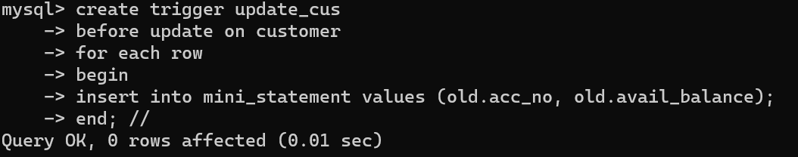
Trigger to insert (old) values into a mini_statement record (including account number and available balance as parameters) before updating any record in customer record/table:

Slide 71
Making updates to invoke trigger:
delimiter;
update customer set avail_balance = avail_balance + 3000 where acc_no = 1001;
update customer set avail_balance = avail_balance + 3000 where acc_no = 1000;

Slide 72
select * from mini_statement;
+--------+---------------+
| acc_no | avail_balance |
+--------+---------------+
| 1001 | 12000 |
| 1000 | 7000 |
+--------+---------------+
2 rows in set (0.0007 sec)

Slide 73
2. After Update Trigger:
As the name implies, this trigger is invoked after an updation occurs. (i.e., it gets implemented after an update statement is executed.).
create table micro_statement (acc_no integer,
avail_balance decimal,
foreign key(acc_no) references customer(acc_no) on delete cascade);
Insert another value into customer:
insert into customer values (1002, "Janitor", 4500);
Query OK, 1 row affected (0.0786 sec)

Slide 74
Trigger to insert (new) values of account number and available balance into micro_statement record after an update has occurred:
delimiter //
create trigger update_after
-> after update on customer
-> for each row
-> begin
-> insert into micro_statement values(new.acc_no, new.avail_balance);
-> end; //

Slide 75
delimiter ;
update customer set avail_balance = avail_balance + 1500 where acc_no = 1002;
select * from micro_statement;
+--------+---------------+
| acc_no | avail_balance |
+--------+---------------+
| 1002 | 6000 |
+--------+---------------+
1 row in set (0.0007 sec)

Slide 76
3. Before Insert Trigger:
As the name implies, this trigger is invoked before an insert, or before an insert statement is executed.
Considering tables:
create table contacts (contact_id INT (11) NOT NULL AUTO_INCREMENT,
last_name VARCHAR (30) NOT NULL, first_name VARCHAR (25),
birthday DATE, created_date DATE,
created_by VARCHAR(30),
CONSTRAINT contacts_pk PRIMARY KEY (contact_id));

Slide 77
delimiter //
create trigger contacts_before_insert
before insert
on contacts for each row
begin
DECLARE vUser varchar(50);
select USER() into vUser;
SET NEW.created_date = SYSDATE();
SET NEW.created_by = vUser;
end; //
Trigger to insert contact information such as name, birthday and creation-date/user into a table contact before an insert occurs:

Slide 78
Making an insert to invoke the trigger:
delimiter;
insert into contacts values (1, "Newton", "Enigma",
str_to_date ("19-08-1999", "%d-%m-%Y"),
str_to_date ("17-03-2018", "%d-%m-%Y"), "xyz");
Output:
select *from contacts;
+------------+-----------+------------+------------+--------------+----------------+
| contact_id | last_name | first_name | birthday | created_date | created_by |
+------------+-----------+------------+------------+--------------+----------------+
| 1 | Newton | Enigma | 1999-08-19 | 2019-05-11 | root@localhost |
+------------+-----------+------------+------------+--------------+----------------+

Slide 79
4. After Insert Trigger:
As the name implies, this trigger gets invoked after an insert is implemented.
Consider tables:
create table contacts (contact_id int (11) NOT NULL AUTO_INCREMENT,
last_name VARCHAR(30) NOT NULL,
first_name VARCHAR(25), birthday DATE,
->CONSTRAINT contacts_pk PRIMARY KEY (contact_id));
create table contacts_audit (contact_id integer,
created_date date,
created_by varchar (30));

Slide 80
Trigger to insert contact_id and contact creation-date/user information into contacts_audit record after an insert occurs:
delimiter //
create trigger contacts_after_insert
-> after insert
-> on contacts for each row
-> begin
-> DECLARE vUser varchar(50);
->
-> -- Find username of person performing the INSERT into table
-> SELECT USER() into vUser;
->
-> -- Insert record into audit table
-> INSERT into contacts_audit
-> ( contact_id,
-> created_date,
-> created_by)
-> VALUES
-> ( NEW.contact_id,
-> SYSDATE(),
-> vUser );
-> END; //

Slide 81
Making an insert to invoke the trigger:
insert into contacts values (1, "Kumar", "Rupesh",
str_to_date("20-06-1999", "%d-%m-%Y"));
Output:
select *from contacts_audit;
+------------+--------------+----------------+
| contact_id | created_date | created_by |
+------------+--------------+----------------+
| 1 | 2019-05-11 | root@localhost |
+------------+--------------+----------------+
1 row in set (0.0006 sec)

Slide 82
5. Before Delete Trigger:
As the name implies, this trigger is invoked before a delete occurs, or before deletion statement is implemented.
Consider tables:
create table contacts (contact_id int (11) NOT NULL AUTO_INCREMENT,
last_name VARCHAR (30) NOT NULL, first_name VARCHAR (25),
birthday DATE, created_date DATE, created_by VARCHAR(30),
CONSTRAINT contacts_pk PRIMARY KEY (contact_id));
create table contacts_audit (contact_id integer, deleted_date date, deleted_by varchar(20));

Slide 83
Trigger to insert contact_id and contact deletion-date/user information into contacts_audit record before a delete occurs:
delimiter //
create trigger contacts_before_delete
-> before delete
-> on contacts for each row
-> begin
->
-> DECLARE vUser varchar(50);
->
-> -- Find username of person performing the DELETE into table
-> SELECT USER() into vUser;
->
-> -- Insert record into audit table
-> INSERT into contacts_audit
-> ( contact_id,
-> deleted_date,
-> deleted_by)
-> VALUES
-> ( OLD.contact_id,
-> SYSDATE(),
-> vUser );
-> end; //

Slide 84
Making an insert and then deleting the same to invoke the trigger:
delimiter;
insert into contacts values (1, "Bond", "Ruskin",
str_to_date ("19-08-1995", "%d-%m-%Y"),
str_to_date ("27-04-2018", "%d-%m-%Y"), "xyz");
delete from contacts where last_name="Bond";
Output:
select *from contacts_audit;
+------------+--------------+----------------+
| contact_id | deleted_date | deleted_by |
+------------+--------------+----------------+
| 1 | 2019-05-11 | root@localhost |
+------------+--------------+----------------+
1 row in set (0.0007 sec)

Slide 85
6. After Delete Trigger:
As the name implies, this trigger is invoked after a delete occurs, or after a delete operation is implemented.
Consider the tables:
create table contacts (contact_id int (11) NOT NULL AUTO_INCREMENT,
last_name VARCHAR (30) NOT NULL, first_name VARCHAR (25),
birthday DATE, created_date DATE, created_by VARCHAR (30),
CONSTRAINT contacts_pk PRIMARY KEY (contact_id));
create table contacts_audit (contact_id integer, deleted_date date, deleted_by varchar(20));

Slide 86
Trigger to insert contact_id and contact deletion-date/user information into contacts_audit record after a delete occurs:
create trigger contacts_after_delete
-> after delete
-> on contacts for each row
-> begin
->
-> DECLARE vUser varchar(50);
->
-> -- Find username of person performing the DELETE into table
-> SELECT USER() into vUser;
->
-> -- Insert record into audit table
-> INSERT into contacts_audit
-> ( contact_id,
-> deleted_date,
-> deleted_by)
-> VALUES
-> ( OLD.contact_id,
-> SYSDATE(),
-> vUser );
-> end; //

Slide 87
Making an insert and deleting the same to invoke the trigger:
delimiter;
insert into contacts values (1, "Newton", "Isaac",
str_to_date ("19-08-1985", "%d-%m-%Y"),
str_to_date ("23-07-2018", "%d-%m-%Y"), "xyz");
delete from contacts where first_name="Isaac";
Output:
select *from contacts_audit;
+------------+--------------+----------------+
| contact_id | deleted_date | deleted_by |
+------------+--------------+----------------+
| 1 | 2019-05-11 | root@localhost |
+------------+--------------+----------------+
1 row in set (0.0009 sec)

Slide 88
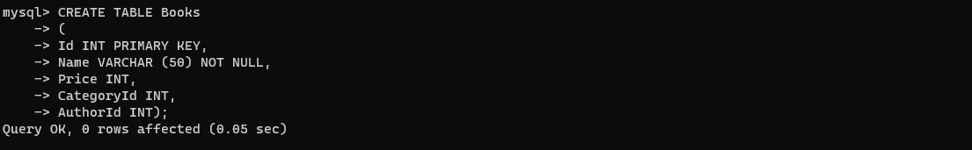
NESTED, CORRELATED, JOIN QUERIES

Slide 89
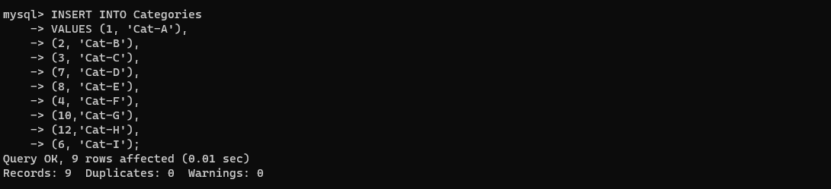
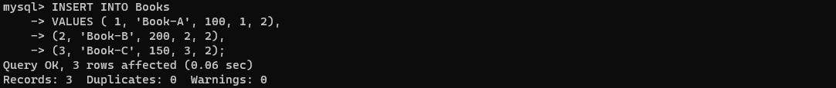

Slide 90
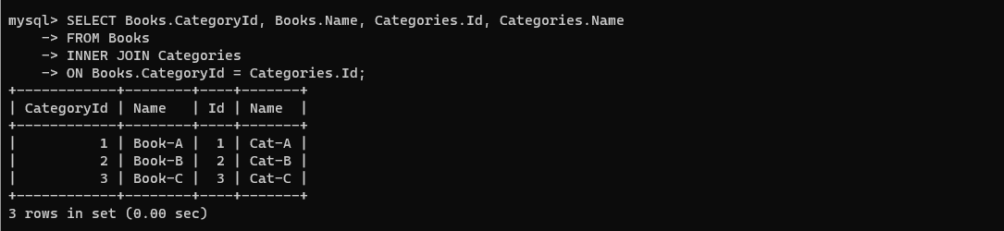
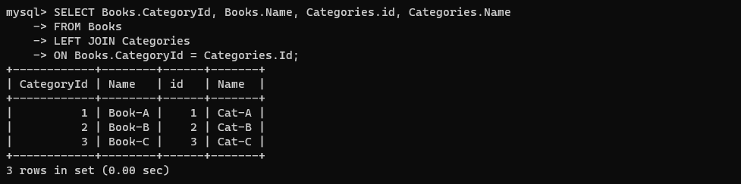

Slide 91
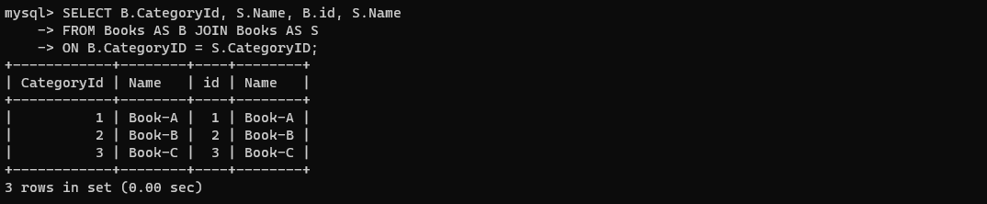

Slide 92
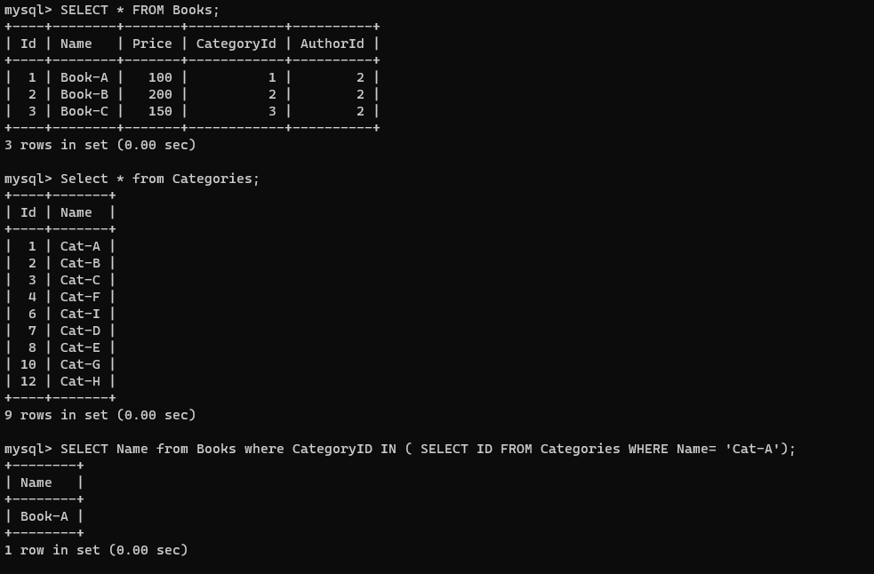
NESTED QUERY

Slide 93
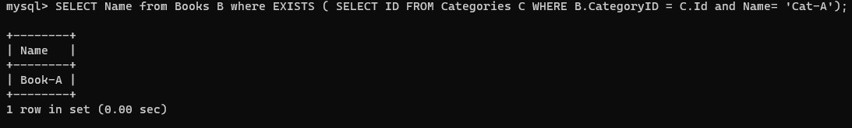
CORRELATED QUERY

Slide 94
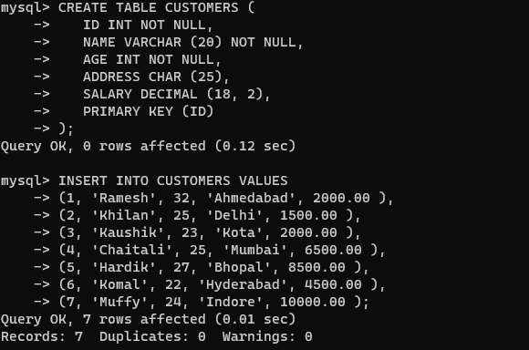
ANY AND ALL OPERATORS

Slide 95
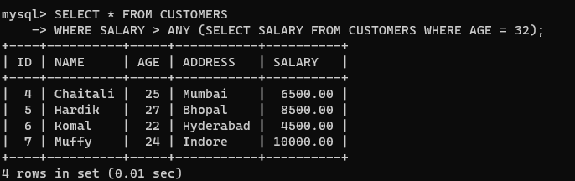
The ANY operator is used to verify if any single record of a query satisfies the required condition.
This operator returns a TRUE, if the given condition is satisfied for any of the values in the range. If none of the values in the specified range satisfy the given condition, this operator returns false. You can also use another query (subquery) along with this operator.
let us list out the details of all the CUSTOMERS whose SALARY is greater than the SALARY of any customer whose AGE is 32

Slide 96
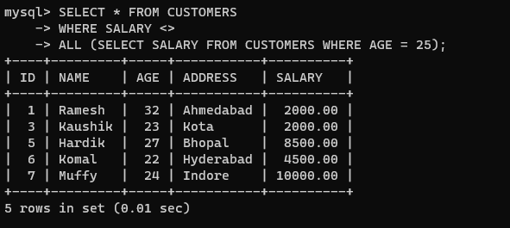
The SQL ALL operator returns all the records of the SELECT statement.
It returns TRUE if the given condition is satisfied for ALL the values in the range.
It always returns a Boolean value.
It is used with SELECT, WHERE and HAVING statements in SQL queries.
The data type of the values returned from a subquery must be the same as the outer query expression data type.

Slide 97
THANK YOU

